Slide 1
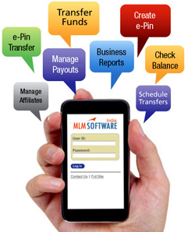
MOBILE BANKING

Slide 2



Mobile Banking (Financial)
Financial Mobile Banking services have been approved by RBI.
The APP is now available on the play store for android devices.
The customer can use mobile banking for the below services
Account inquiry | Stop / Revoke Cheque
Transfer funds ( Within Bank ,Own Account, IMPS, NEFT,RTGS) | ATM Card Manage
Recharge and Bill Payment | Link Of Aadhaar
Cheque Book Request | Standing Instruction
www.adcbank.coop info@adcbank.coop

Slide 3
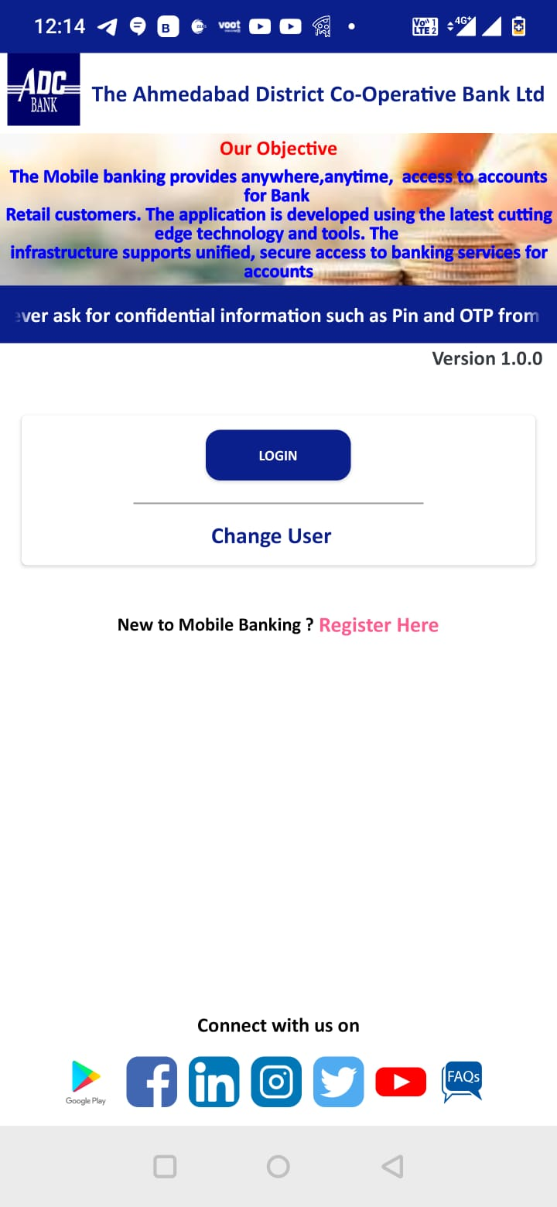
First screen - Mobile APP
Once the INSTALLATION is successful the screen will appear as shown in the same slide.
Following MENU appears on the APP screen:
1) Click On Register Here
2)After Enter Mandatory Fields
3) After Enter OTP
4) After Enter MPIN & T Pin
5) After Enter Security Question
6) After Enter Submit button

Slide 4
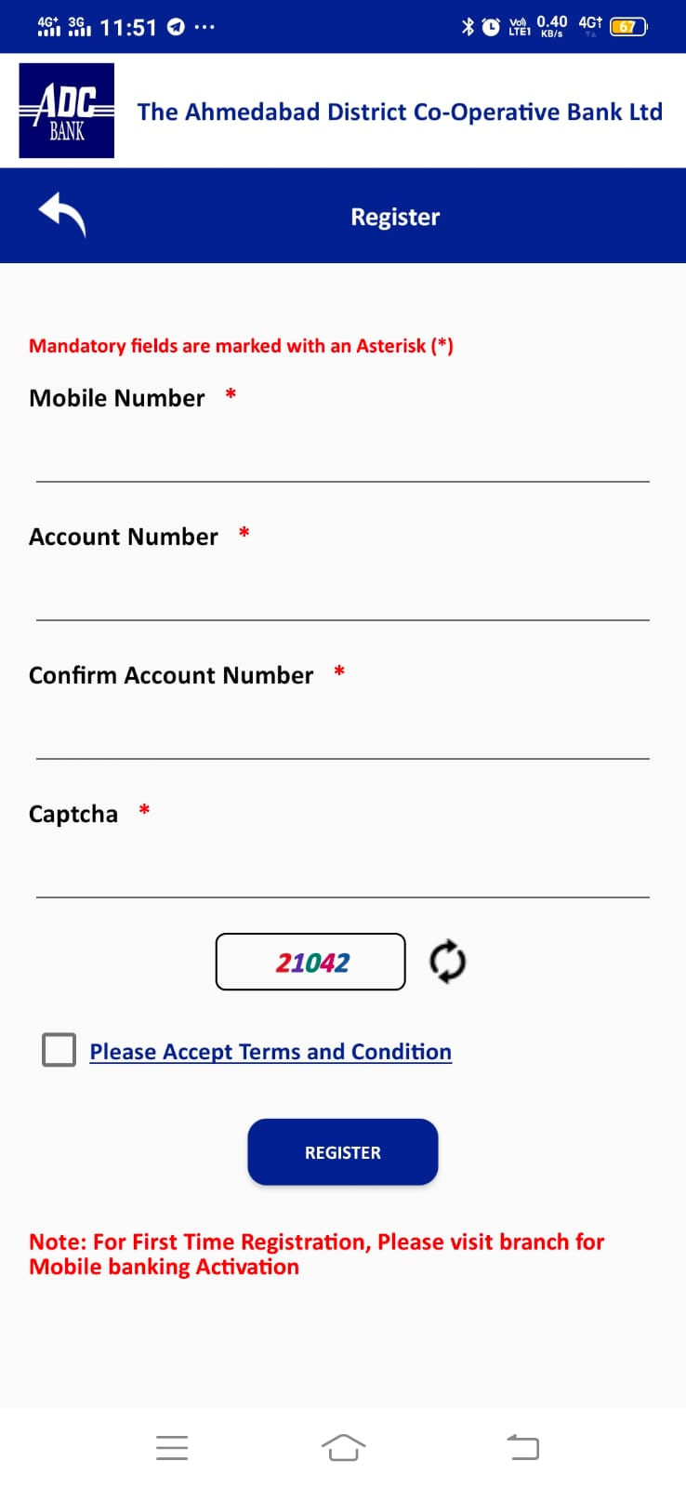
NEW REGISTRATION Screen
On clicking New Registration Application will ask to Enter Account Number.
Enter Your Mobile Number, Account Number , Confirm Account Number, Captcha. Then Please Accept Terms and Condition to proceed further.

Slide 5
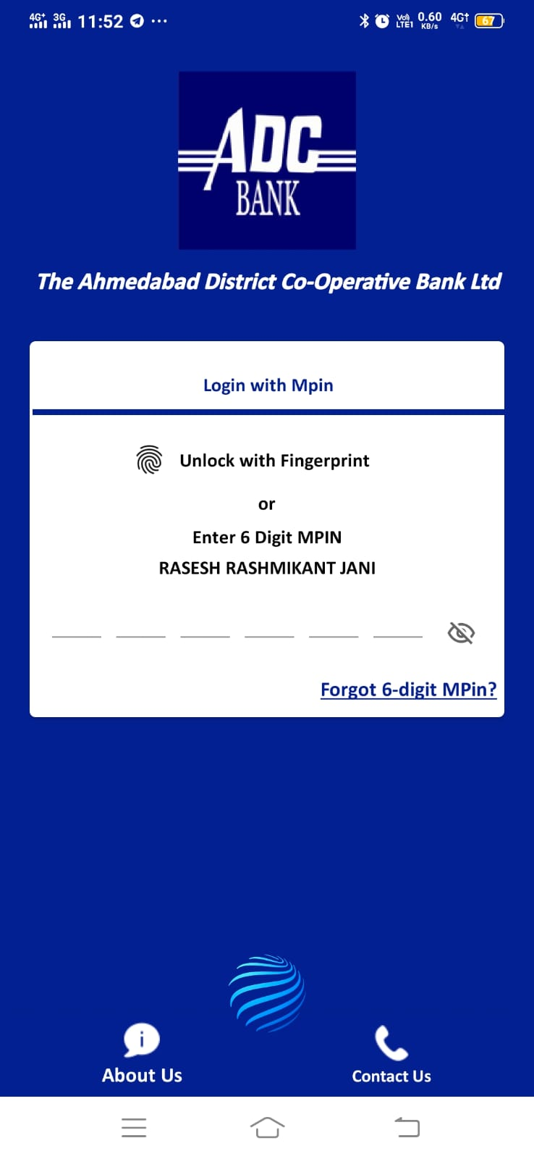
LOGIN Screen
After Successful completion of registration Login Screen will appear.
USER NAME will display automatically
Enter 6-digit Pin Number and click LOGIN

Slide 6
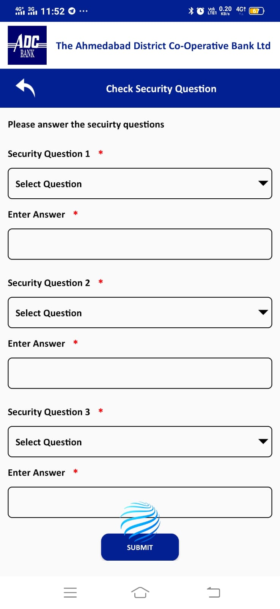
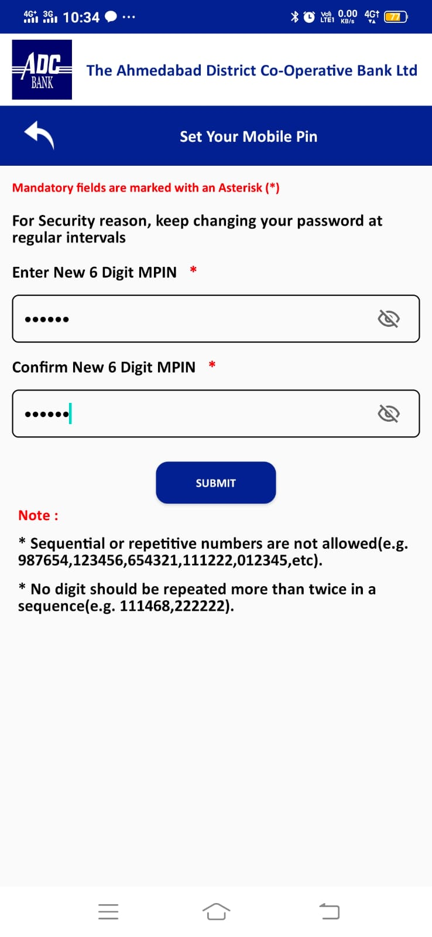
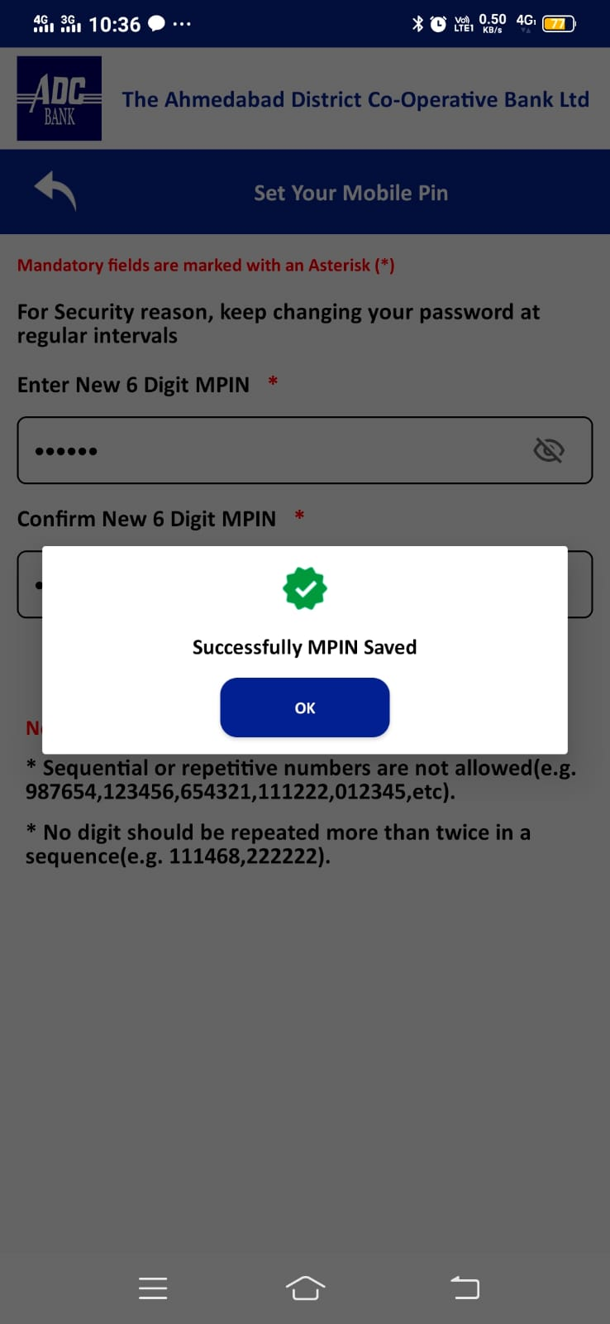
Forgot M-pin
When user click on Forgot Mpin a OTP will sent to user’s registered mobile number
After entering OTP user can change Mpin

Slide 7
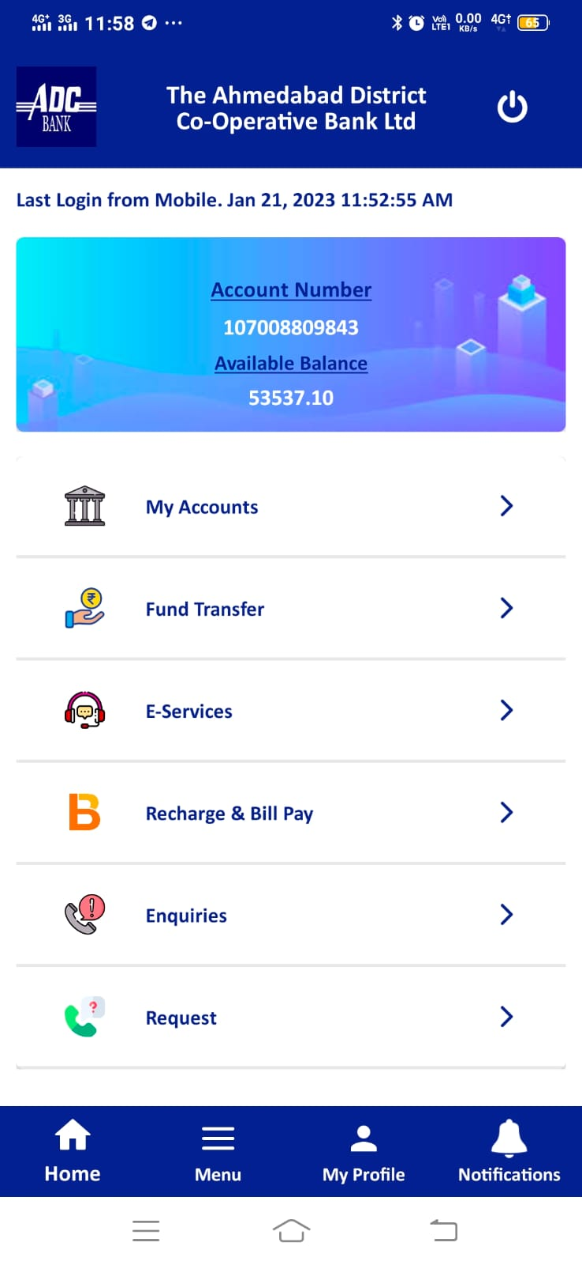
Home screen - Mobile APP
After Login User Home screen will appear.
Following details are mentioned in the Home screen:
My Accounts
Fund Transfer
E-Service
Recharge & Bill Pay
Enquires
Request
My Profile
Notification
Logout

Slide 8
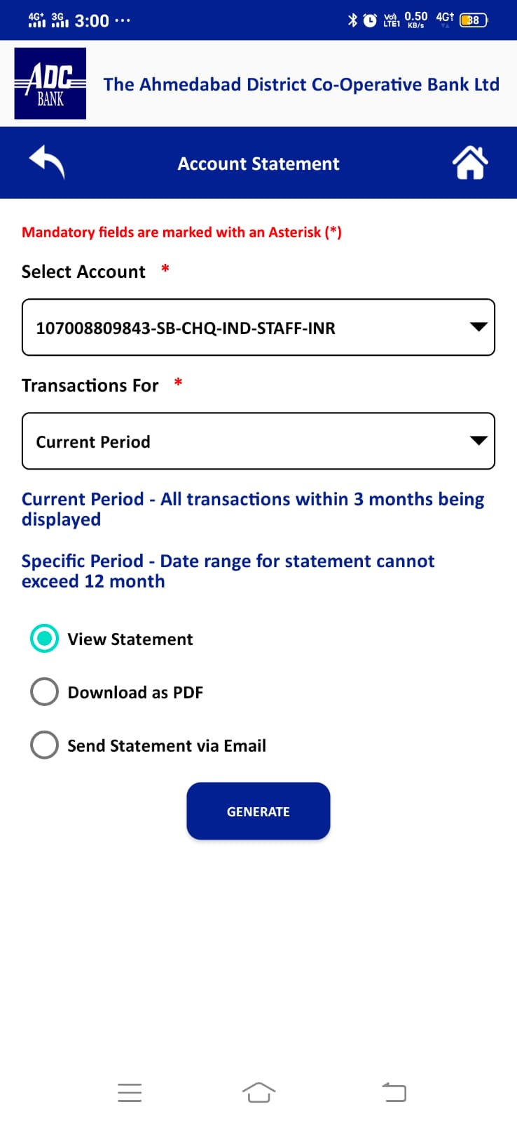
ACCOUNT STATEMENT –My Account
Account Statement Will Display transaction made from that Account.

Slide 9
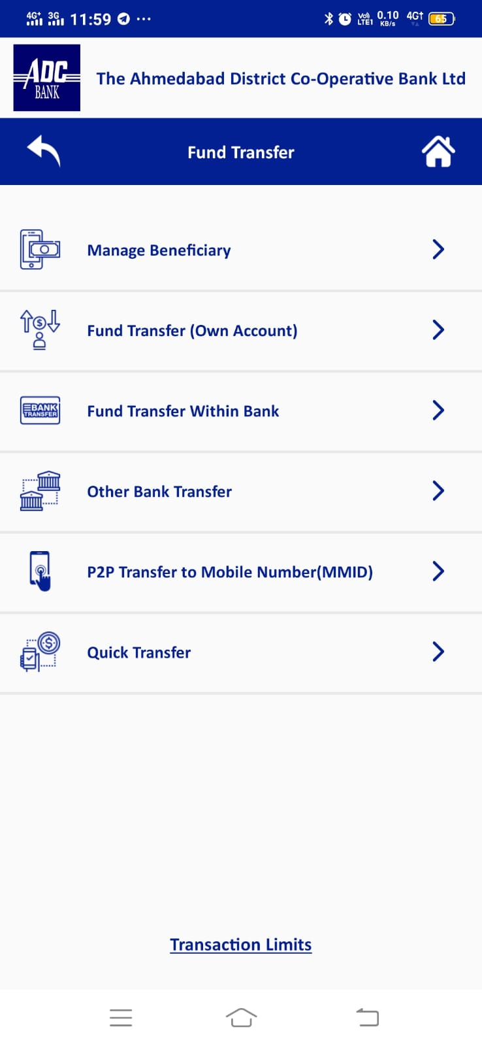
FUND TRANSFER WITHIN BANK And Other Bank – Fund Transfer
Fund Transfer will display information as below
Manage Beneficiary
Own Account Transfer (Self Account ADC to ADC)
Fund Transfer Within Bank(ADC to ADC Quick Transfer)
Other Bank Transfer(ADC to Other beneficiary Transfer)
P2P Transfer to Mobile Number(MMID)
Quick Transfer

Slide 10
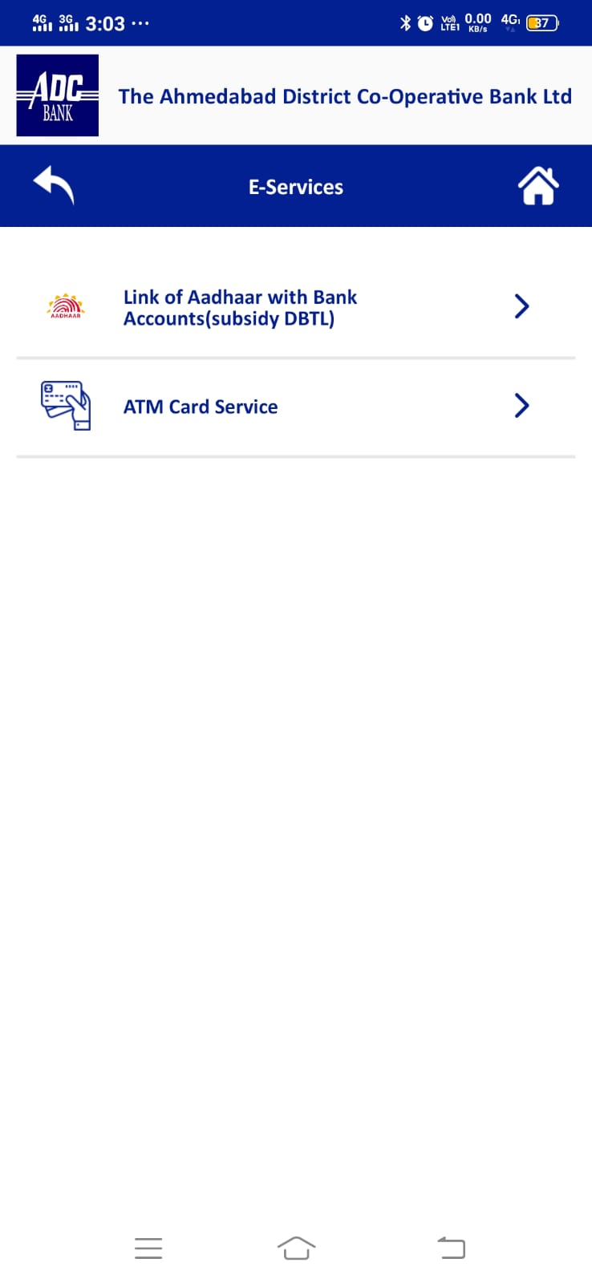
E-Service
E-Service
Link of Aadhaar with Bank Account
ATM Card Service

Slide 11
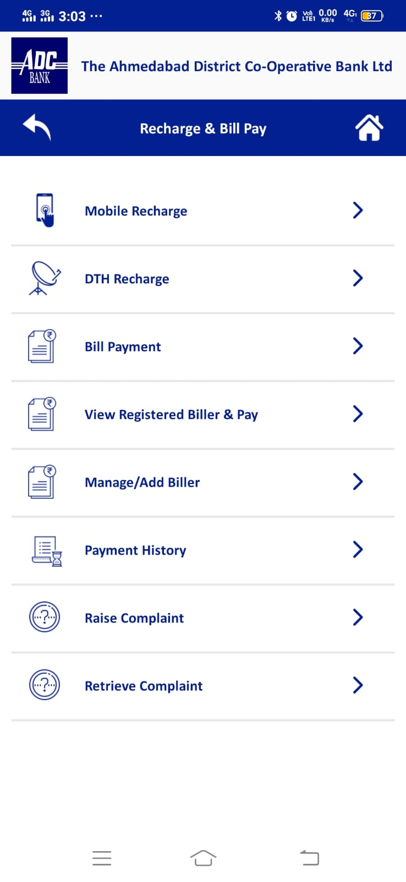
Recharge & Bill Pay
Recharge & Bill Pay
Mobile Recharge
DTH Recharge
Bill Payment
View Registered Biller & Pay
Manage /Add Biller
Payment History
Raise Complaint
Retrieve Complaint

Slide 12
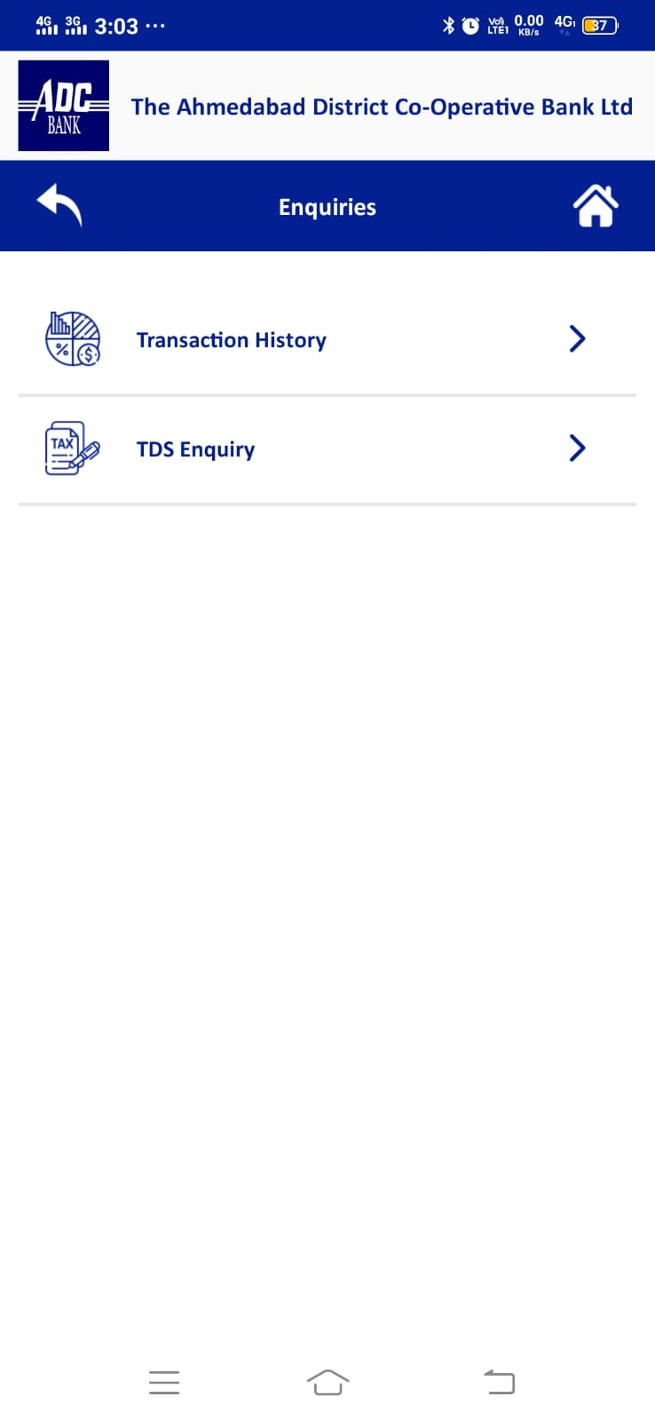
Enquiries
Enquiries
Transaction History
TDS Enquiry

Slide 13
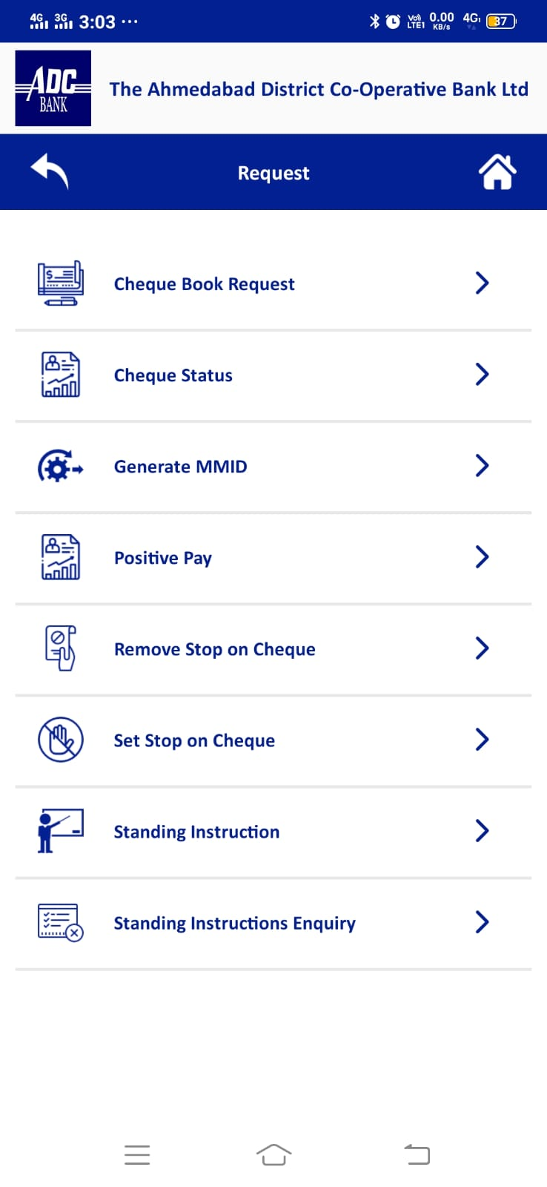
Request
Request
Cheque Book Request
Cheque Status
Generate MMID
Positive Pay
Remove stop on Cheque
Set Stop on Cheque
Standing Instruction
Standing Instruction Enquiry

Slide 14


Since 1925
www.adcbank.coop
Ib.mb@adcbank.coop

