Slide 1

ATM CARD Registration
Since 1925

Slide 2



ATM CARD Registration
Since 1925

Slide 3

Step 1 – Open www.adcbank.coop
Since 1925
Click
here

Slide 4
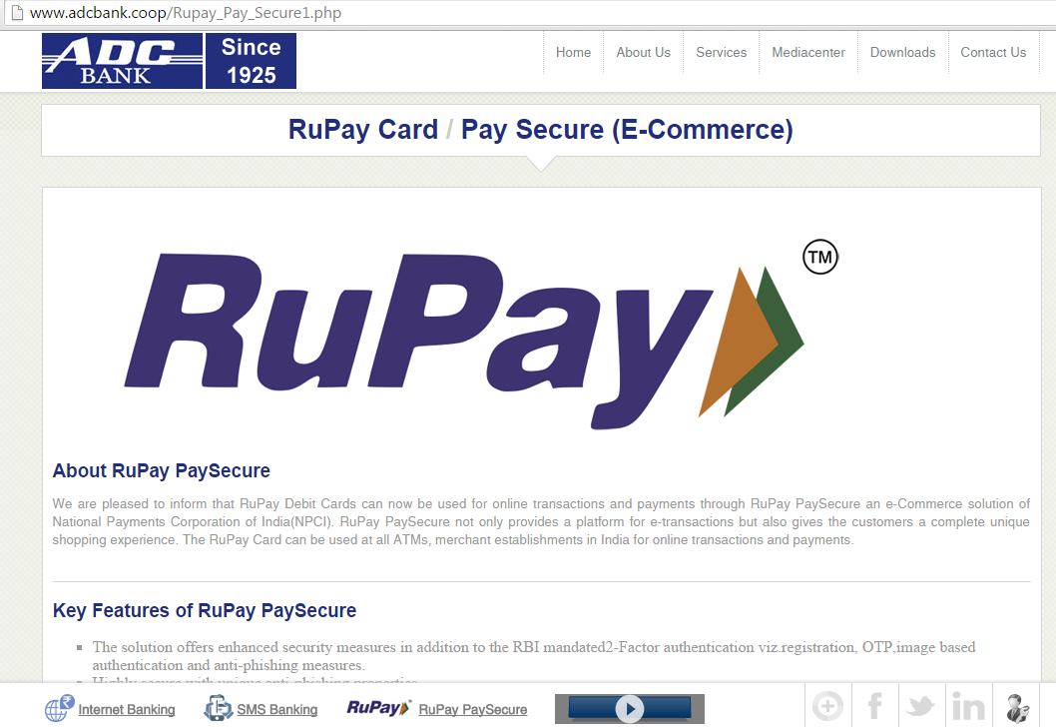
Step 2 – Scroll down to the bottom of the page
Since 1925
SCROLL DOWN

Slide 5
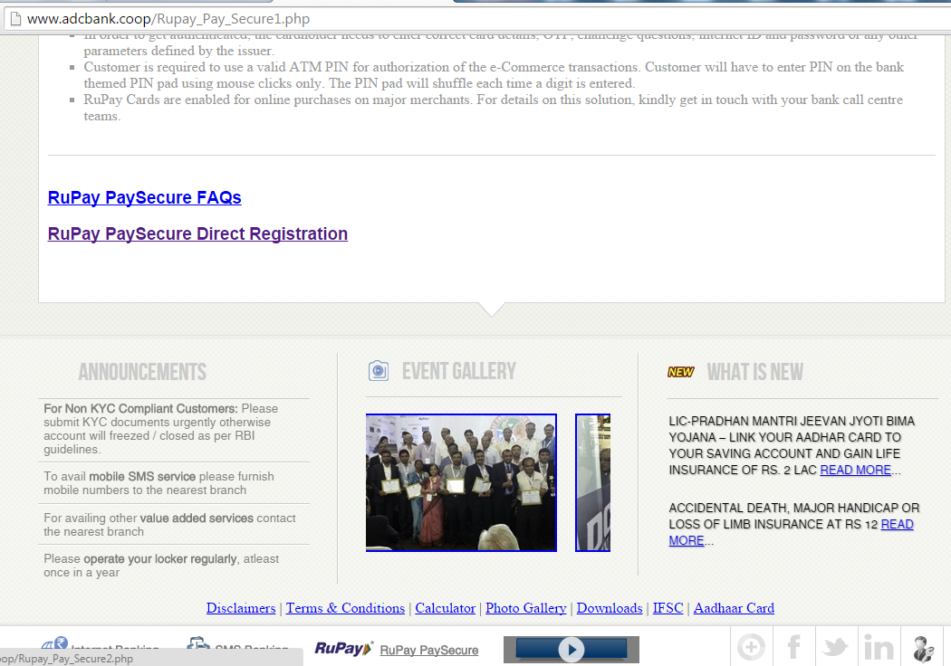
Step 3 – Click on
“RuPay PaySecure FAQs”
Since 1925
Click
here

Slide 6
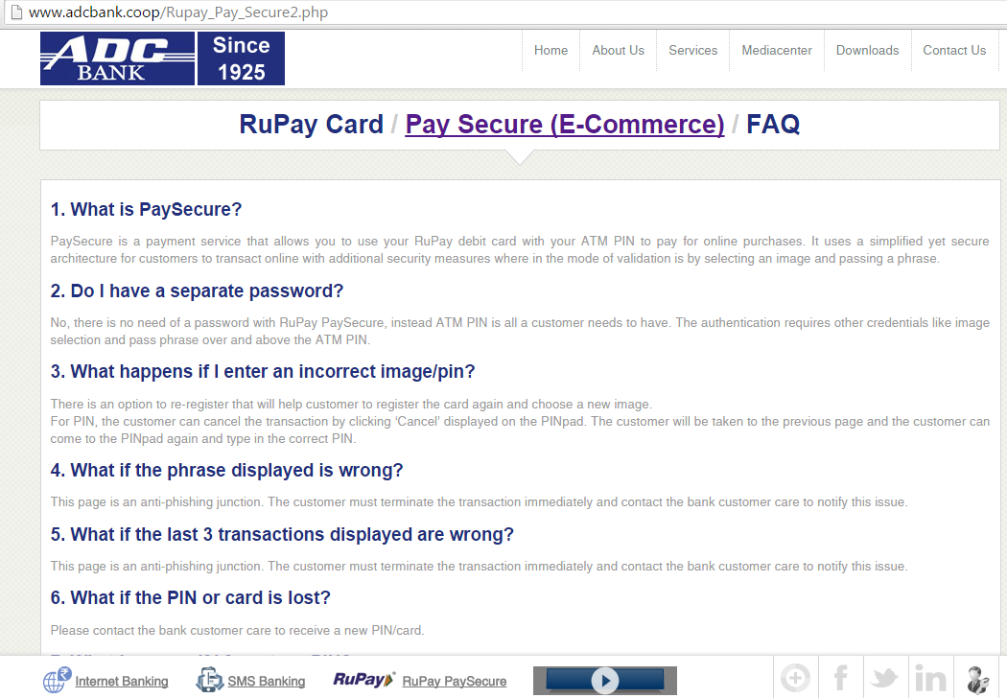
Step 4 – Read all 19 Questions
Since 1925

Slide 7
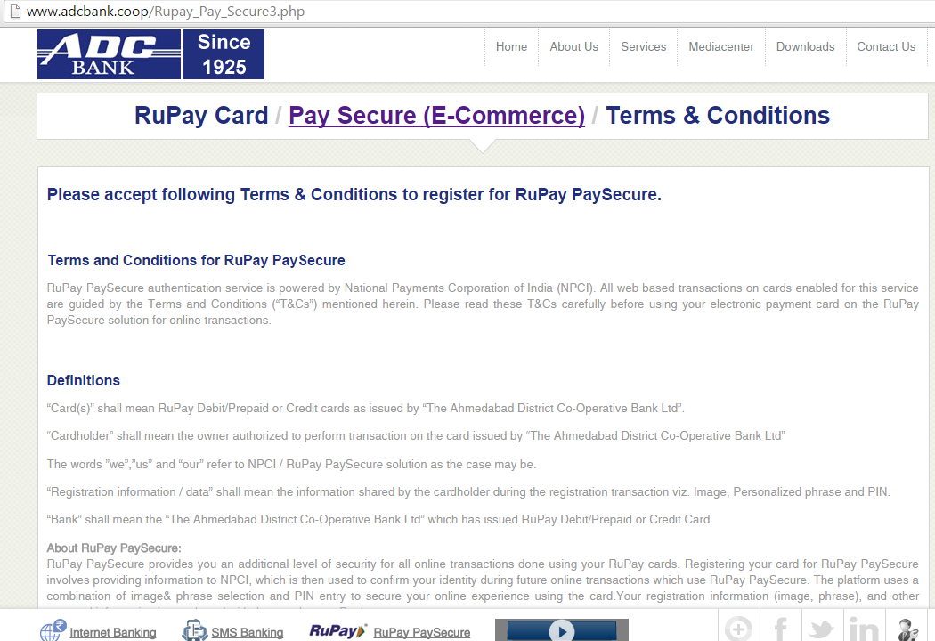
Step 5 – Click on
“Pay Secure (E-Commerce)”
Since 1925
Click
here

Slide 8
Step 5 – Click on
“RuPay PaySecure Direct Registration”
Since 1925
SCROLL DOWN
Click
here

Slide 9
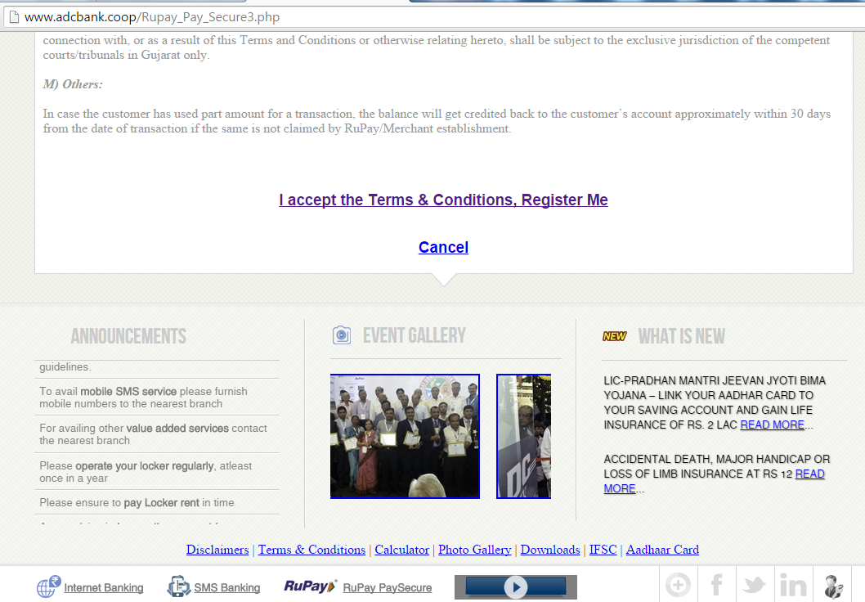
Step 6 – Click on
“I accept the Terms & Conditions, Register Me”
Since 1925
SCROLL DOWN
Click
here

Slide 10
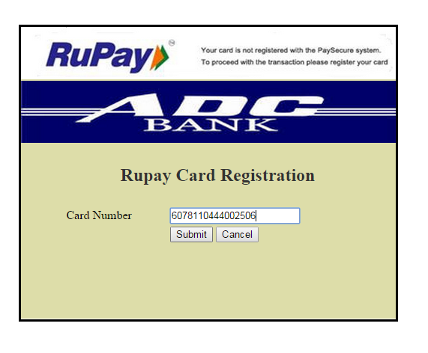
Step 7 – New screen will appear, Enter the 16 digit ATM card number
and click on SUBMIT
Since 1925
Enter 16 Digit ATM card number

Slide 11
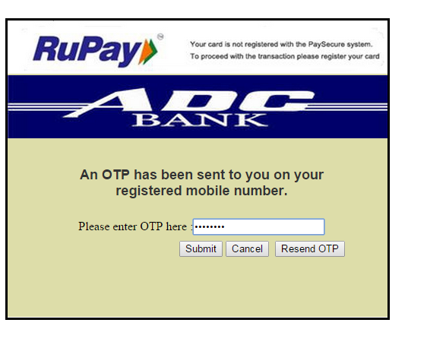
Step 8 – Enter the 8 digit OTP which will be received on registered mobile number
and click on SUBMIT
Since 1925
Enter 8 Digit ATM card number

Slide 12
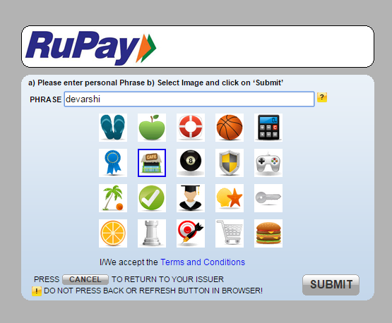
Step 9 – Enter any word in the PHRASE BOX
& select any image (select the image that can remember)
and click on SUBMIT
Since 1925
Enter any word in the PHRASE BOX
Select any image from the images displayed on the screen.
Please remember the image that is selected by you.

Slide 13
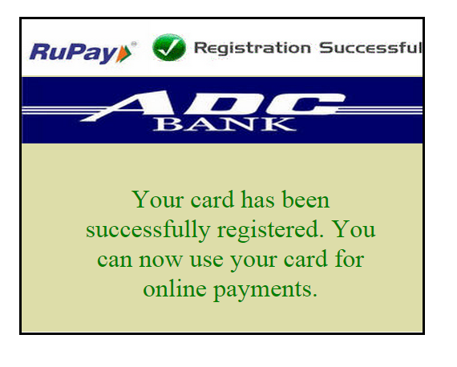
Registration for E-Commerce or online payment is successful.
Since 1925

Slide 14



Since 1925
Since 1925
www.adcbank.coop
Ib.mb@adcbank.coop

